Slide 1
International Monetary Fund
Subject Code – FT 405F/IM805F, International Finance
Dr.Yamini Karmarkar
International Institute of Professional Studies

Slide 2
Why was it created?
The IMF was conceived in July 1944, when representatives of 45 governments meeting in the town of Bretton Woods, New Hampshire, in the northeastern United States, agreed on a framework for international economic cooperation. They believed that such a framework was necessary to avoid a repetition of the disastrous economic policies that had contributed to the Great Depression of the 1930s.

Slide 3
IMF
185 member countries.
Established in 1944 to promote
  international monetary cooperation,
  exchange stability, and
  orderly exchange arrangements;
  to foster economic growth and high levels of employment; and
  to provide temporary financial assistance to countries to help ease balance of payments adjustment

Slide 4
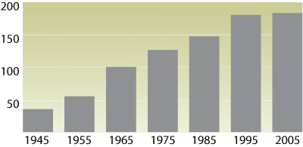
Growth in IMF Membership, 1945 - 2005
(number of countries)

Slide 5
The purposes of the International Monetary Fund
To promote international monetary cooperation through a permanent institution which provides the machinery for consultation and collaboration on international monetary problems.
To facilitate the expansion and balanced growth of international trade, and to contribute thereby to the promotion and maintenance of high levels of employment and real income and to the development of the productive resources of all members as primary objectives of economic policy.

Slide 6
The purposes of the International Monetary Fund
To promote exchange stability, to maintain orderly exchange arrangements among members, and to avoid competitive exchange depreciation.
To assist in the establishment of a multilateral system of payments in respect of current transactions between members and in the elimination of foreign exchange restrictions which hamper the growth of world trade.

Slide 7
The purposes of the International Monetary Fund
To give confidence to members by making the general resources of the Fund temporarily available to them under adequate safeguards, thus providing them with opportunity to correct maladjustments in their balance of payments without resorting to measures destructive of national or international prosperity.
In accordance with the above, to shorten the duration and lessen the degree of dis-equilibrium in the international balances of payments of members

Slide 8
What the IMF Does
Surveillance
lending
technical assistance

Slide 9
Surveillance
overseeing the international monetary system and monitoring the economic and financial policies of its 185 member countries
provide an expert assessment of economic and financial developments, both globally and in individual countries.
It advises on risks to stability and growth and guides the countries if policy adjustments are warranted.

Slide 10
The 2007 Decision on Bilateral Surveillance
countries' policies promote external stability
what is and is not acceptable to the international community in terms of how countries run their exchange rate policies
that surveillance is a collaborative, candid, and evenhanded process between the Fund and its members

Slide 11
Lending
provide loans to countries experiencing balance of payments problems.
  enables countries to rebuild their international reserves;
  stabilize their currencies;
  continue paying for imports; and
  restore conditions for strong economic growth.
Unlike development banks, the IMF does not lend for specific projects.

Slide 12
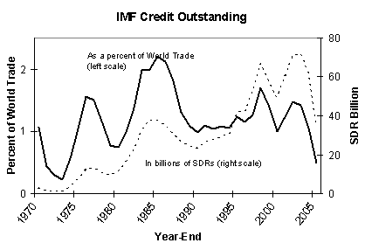
IMF Lending

Slide 13
IMF Lending
Poverty Reduction and Growth Facility (PRGF) and Exogenous Shocks Facility (ESF). The interest rate levied on PRGF and ESF loans is only 0.5 percent, and loans are to be repaid over a period of 5½-10 years.
Stand-By Arrangements (SBA). For short-term balance of payments problems. The length of a SBA is typically 12-24 months,
Extended Fund Facility (EFF). This facility was established in 1974 to help countries address longer-term balance of payments problems. Repayment within 4½-7 years.

Slide 14
IMF lending
Supplemental Reserve Facility (SRF). From 1997 to meet a need for very short-term financing on a large scale. The motivation for the SRF was the sudden loss of market confidence experienced by emerging market economies in the 1990s, which led to massive outflows of capital and required financing on a much larger scale than the IMF had previously provided. Repay within 2-2½ years, but may request an extension of up to six months. All SRF loans carry a substantial surcharge of 3-5 percentage points.

Slide 15
IMF lending
Compensatory Financing Facility (CFF). Assist countries experiencing either a sudden shortfall in export earnings or an increase in the cost of cereal imports, often caused by fluctuating world commodity prices.
Emergency assistance. The IMF provides emergency assistance to countries that have experienced a natural disaster or are emerging from conflict. Emergency loans are subject to the basic rate of charge, although interest subsidies are available for PRGF-eligible countries, subject to availability. Loans must be repaid within 3¼-5 years.

Slide 16
Technical Assistance
IMF technical assistance supports the development of the productive resources of member countries by helping them to effectively manage their economic policy and financial affairs. The IMF helps these countries to strengthen their capacity in both human and institutional resources, and to design appropriate macroeconomic, financial, and structural policies

Slide 17
IMF Quotas
Quota subscriptions generate most of the IMF’s financial resources.
Each member country of the IMF is assigned a quota, based broadly on its relative size in the world economy.
A member’s quota determines its maximum financial commitment to the IMF and its voting power, and
has a bearing on its access to IMF financing.
Quotas are denominated in Special Drawing Rights (SDRs), the IMF's unit of account.

Slide 18
Tranches
Gold
Financial Assets
Foreign Currency

Slide 19
Special Drawing Rights
The SDR is an international reserve asset, created in 1969
SDRs are allocated to member countries in proportion to their IMF quotas.
The SDR also serves as the unit of account of the IMF and some other international organizations.
Its value is based on a basket of key international currencies.

Slide 20
Calculating SDR
The currency value of the SDR is determined by summing the values in U.S. dollars, based on market exchange rates, of a basket of major currencies (the U.S. dollar, Euro, Japanese yen, and pound sterling). The SDR currency value is calculated daily and the valuation basket is reviewed and adjusted every five years.

Slide 21
Fast Facts on the IMF
Current membership: 185 countries
Staff: approximately 2,635 from 143 countries
Total Quotas: $338 billion (as of 9/30/07)
Loans outstanding: $17 billion to 68 countries, of which $6 billion to 57 on concessional terms (as of 9/30/07)
Technical Assistance provided: 438.4 person years during FY2007
Surveillance consultations concluded: 134 countries during FY2007, of which 125 voluntarily published information on their consultation.

